Slide 1

Safest Solutions Group
Travel Guide: The better way enjoy your world travel adventure

Slide 2

Choose an Experience
Adventure
Enthusiasm
Discovery

Slide 3

Travel Budget
BON VOYAGE!

Slide 4

Transportation
Car
Ride Share
Taxi
Rental
Air
Int.
Domestic
Rail
Railway

Slide 5
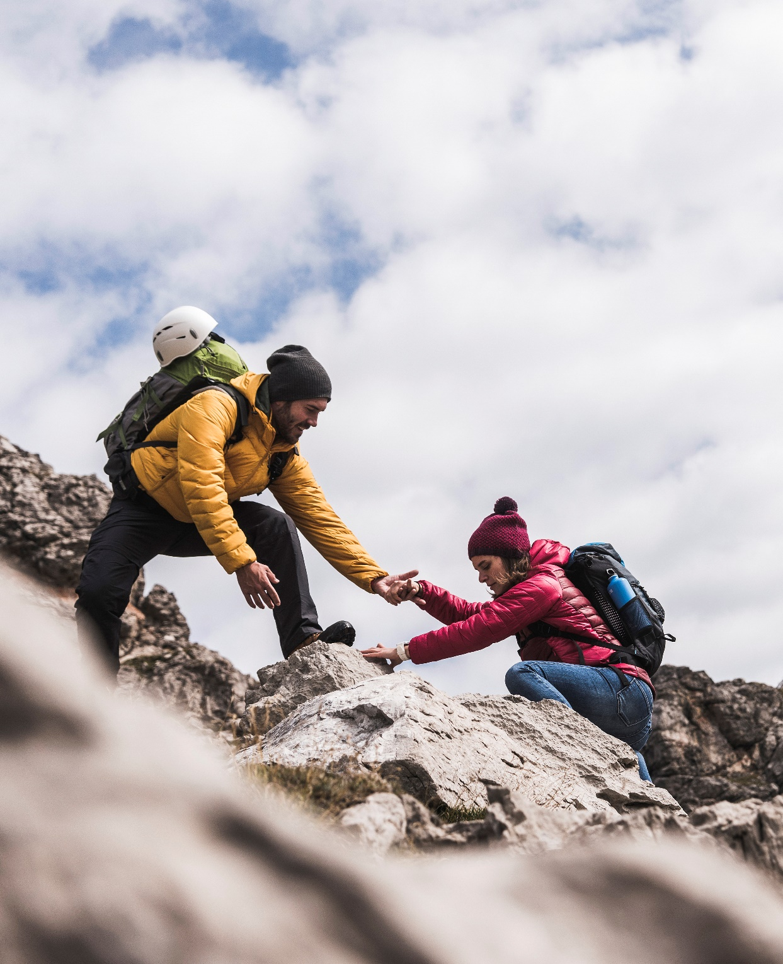
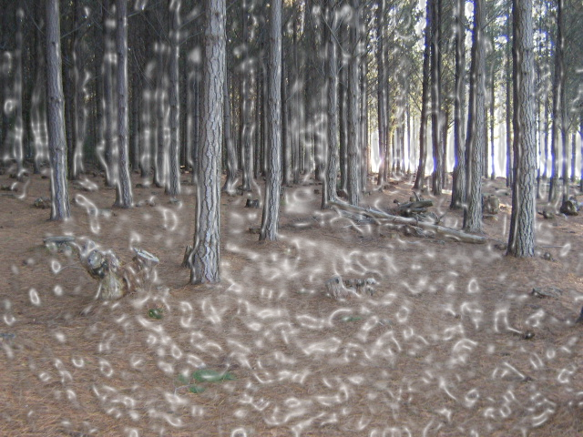
Thank You
furkiddz@safestsol.ni

